Slide 1

PYTHON SCRIPTING IN POWERBI
Subtitle or speaker name

Slide 2
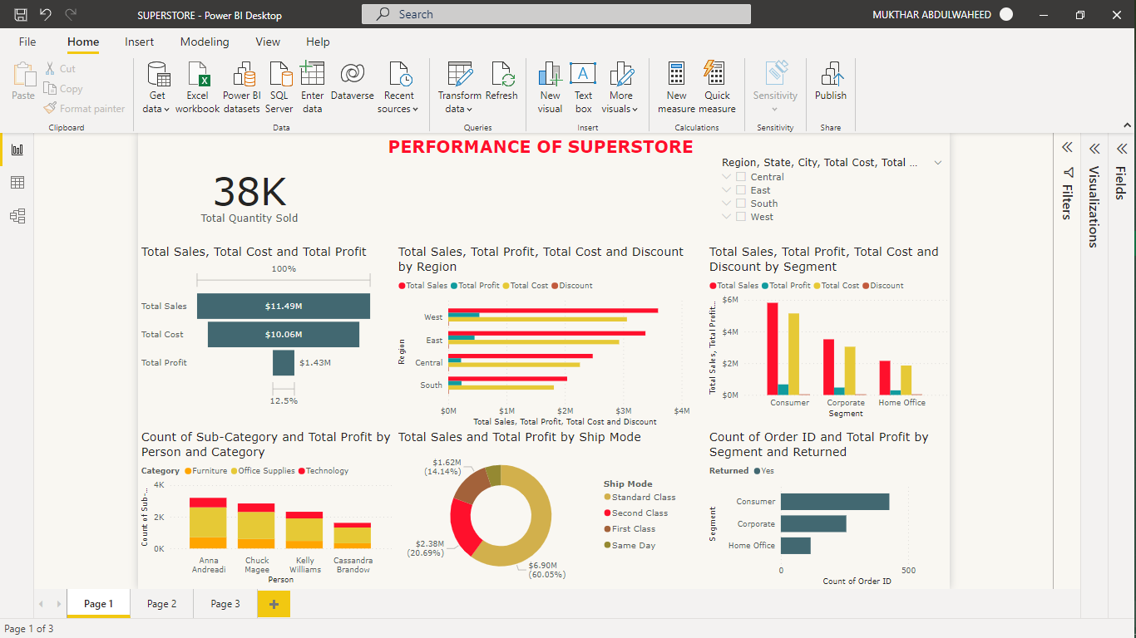
Table of Contents
What is PowerBi?
Why Python in PowerBi?
What is Python Scripting?
How to get started using Python in PowerBi

Slide 3
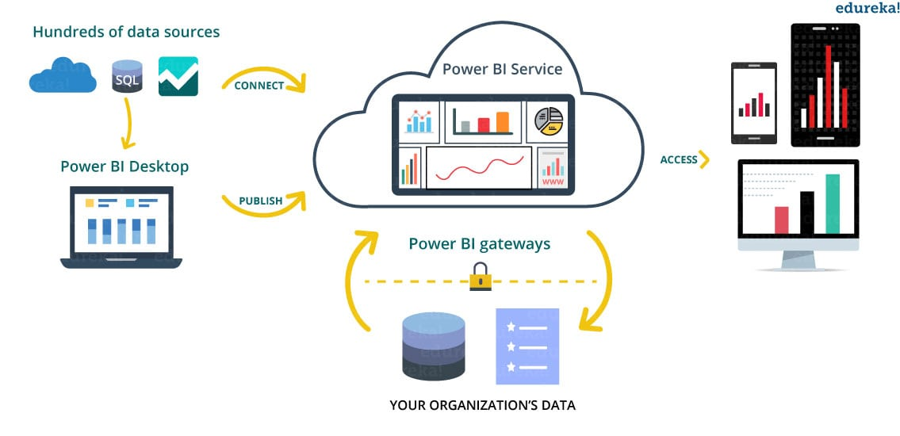
What is PowerBi?
According to Microsoft Docs; Power Bi is a collection of software services, apps, and connectors that work together to turn your unrelated sources of data into coherent, visually immersive and interactive insights.
Microsoft offers three types of Power BI platforms:
Power BI Desktop (A desktop application)
Power BI Service (SaaS i.e., Software as a Service)
Power BI Mobile (For iOS and Android devices)

Slide 4
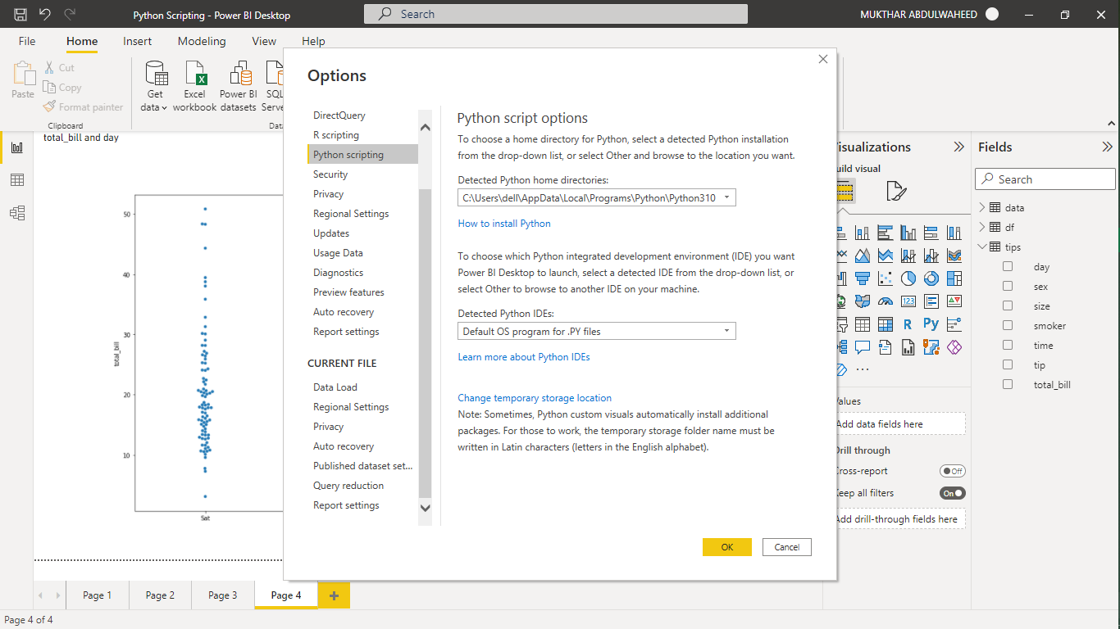
Why Python in PowerBi?
Python is a programming language that can be use for software and web development, it is also used in machine learning, and also to automate task and carry out data analysis.
What is Python used for in PowerBi?
Get Data
Visualize Data

Slide 5
What is Python Scripting?
A Python script is a collection of commands placed in a file that may be run as a program. Of course, the file can have functions and import several modules, but the goal is for it to be run or executed from the command line or within a Python interactive shell to complete a task.
Each line of code is read and executed one at a time by the interpreter., much like a SCRIPT for a play or an audition, hence the name "scripting language." Python is a scripting language because its code is translated and executed by an interpreter.

Slide 6
Let’s get started
How to get started using Python in PowerBi

Slide 7
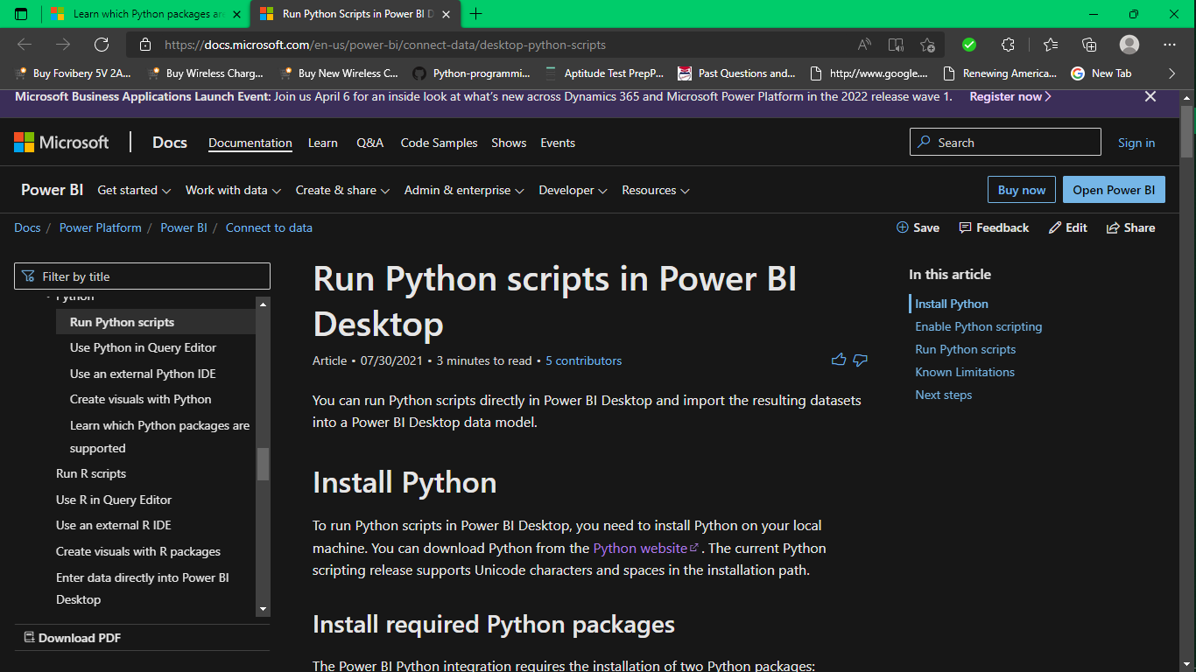
Install Python

Slide 8
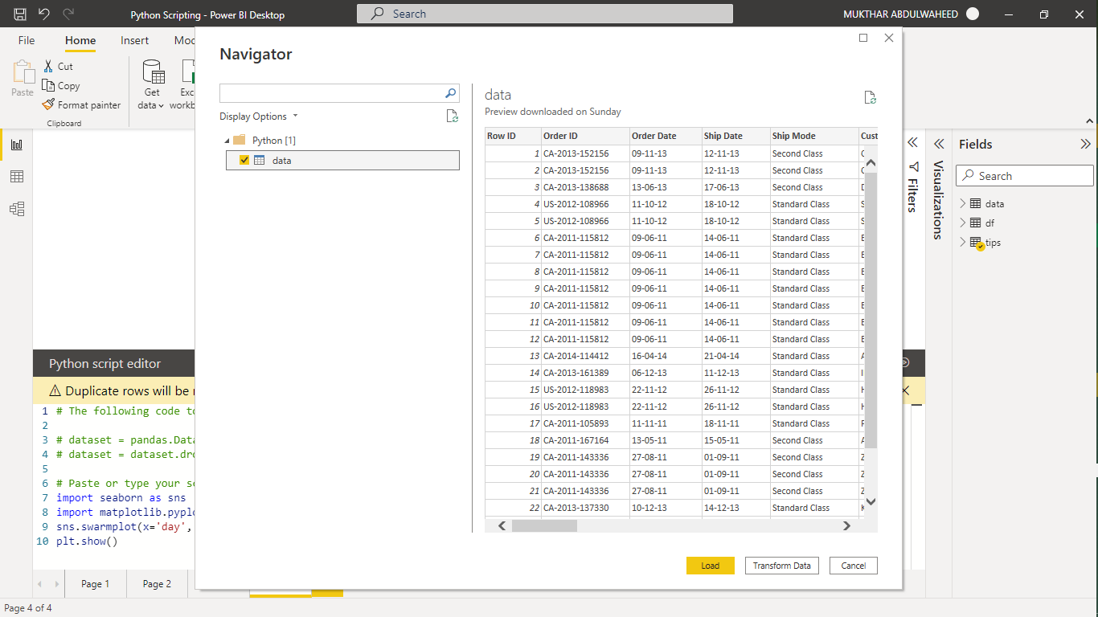
Get Data
Local machine
Online data
Create your own dataset

Slide 9
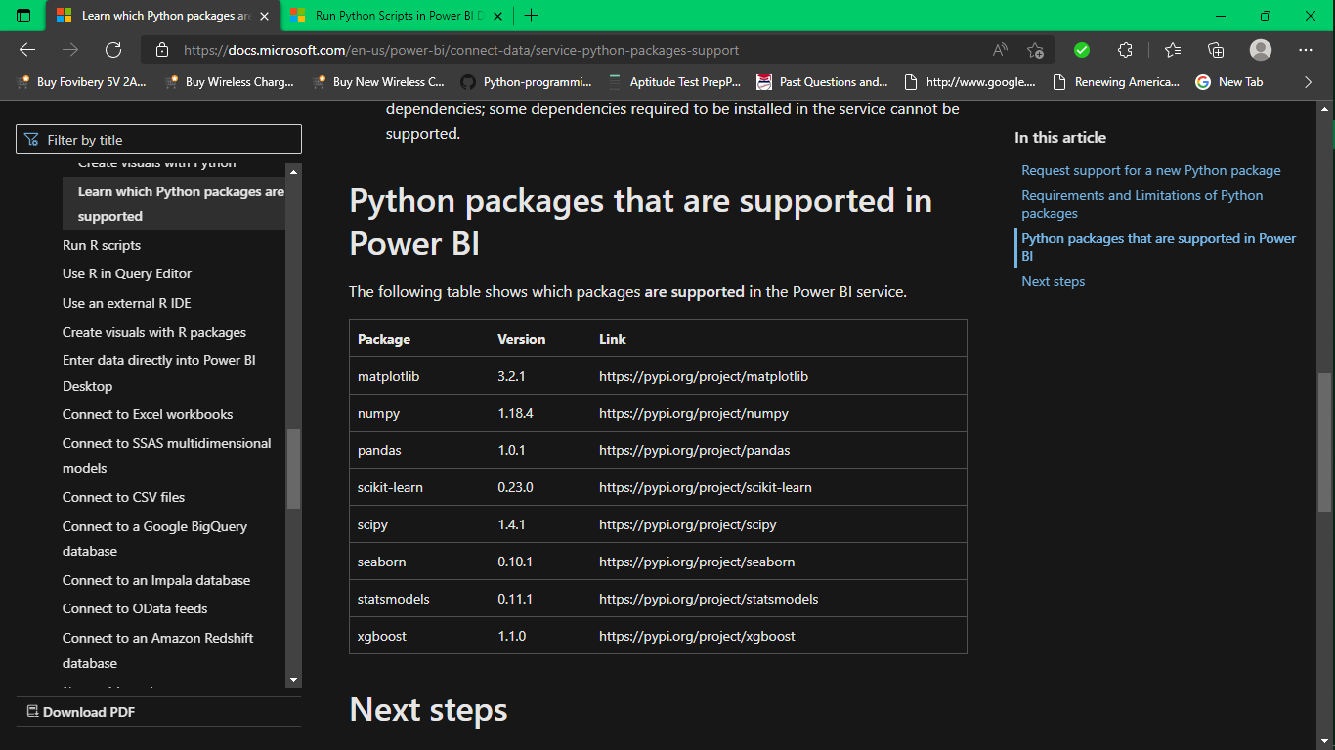
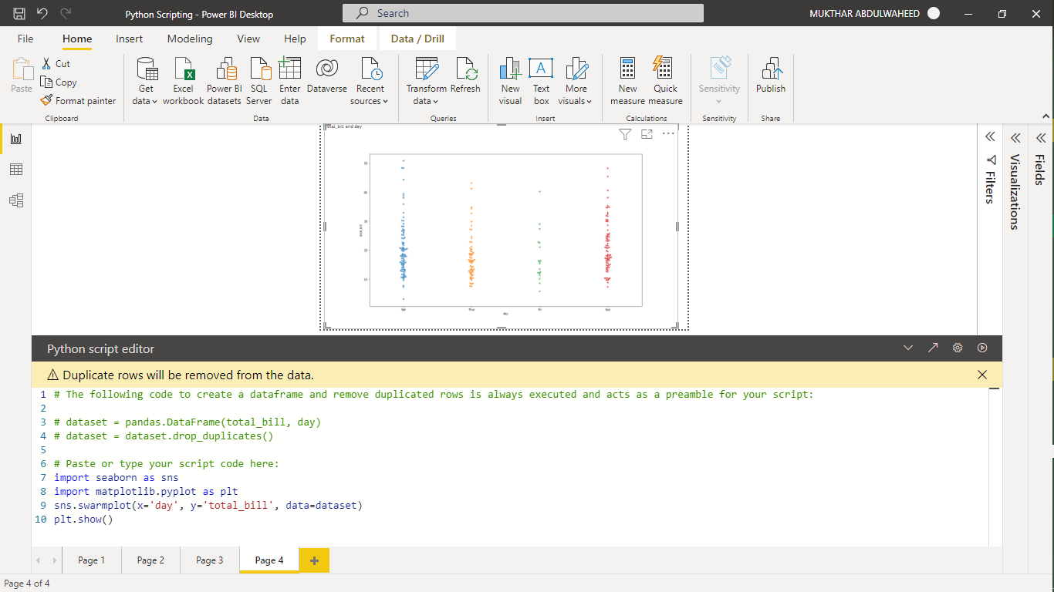
Visualize Data

Slide 10
LINKS TO LEARN & PRACTICE
Work with Power BI visuals
Exploratory Data Analysis using Data Visualization Techniques!
Data Visualization using Matplotlib
How to Perform Exploratory Data Analysis with Seaborn

Slide 11
LET’S PRACTICE

Slide 12

Thank you

